Slide 1




Euphoria Hackathon On SEP Platform
Idea Name : xApps API Usage monitoring via SEP dashboard & Scaling Control
BU : MN-ECP-SEP
Team Name : A-Team
25-10-2021
Ram Misra
Supriya Pal
Srinidhi
Prabhuswamy

Slide 2

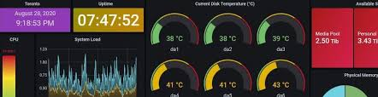






Background of our Idea
SEP Cluster
xApp Cluster
Usecase xApp1
Usecase xApp2
Usecase xApp3
Usecase xApp4
. .
SEP API Gateway
Nokia proprietary and value-added services in the SEP system are mediation xApps. Mediation xApps exposes set of APIs towards use case xApps which can be Nokia or 3rd party developed which acts as clients.
Number of clients could grow over time, and it could proportionally increase the load and expects better reliability on the mediation xApps.
What is the value-add for SEP platform?
Customized monitoring of mediation xApp APIs usage (APIs/sec) in the SEP common dashboard. This could be eventually linked to the licensing
Need based deployment of mediation xApps
Horizontal Autoscaling based on API load
Mediation xApp API usage vs RAN/UE behaviours can be learnt, and it could be used for Self Organized Platform with the aid of AI/ML framework
SEP Dashboard
Service APIs
Mediation xApp1
Mediation xApp2
Mediation xApp3
. .
SEP Platform Service
Kubernetes
Core N/W

Slide 3







Idea Concept
SEP Dashboard
AI/ML Framework
Client
xApp1
Client
xApp2
Client
xApp3
reinforcement
learning
API Static
Monitoring
API Gateway is the single endpoint for all client services hence all API transaction goes via API Gateway. This is the source of data for the situation analysis for our idea.
Ingenious Service is the brain of our idea. It performs following activities:
Periodically (1 sec) fetches API Gateway metrics and parse the data to extract API count per mediation xApp.
Create customer metrics (API rate / sec) and send to Prometheus, which can be viewed in Grafana
If API rate crosses the configured threshold value. It scale out corresponding mediation xApp and scale in if API rate falls lower than 25% of threshold values.
SEP API Gateway
Ingenious Service
Data Streaming
model
Autoscaling / Auto Deployment
Mediation xApp1
Mediation xApp2
Mediation xApp3
SEP Orchestrator
Mediation xApp3
Mediation xApp3

Slide 4
What is innovative here ?
Use case | From Idea | Alternative | Implementation/Future Items
API Usage Monitor | Customized view of API Usage in SEP dashboard. Total xApp API Rate / Sec Individual API Rate Failure rate etc | Kong API Gateway supports GUI to view API Usage. As it is opensourced, it cannot be customized as per our needs. | Implemented : Total xApp API Rate / Sec Future : Individual API Rate Failure rate etc
Auto Deployment | Deployment of mediation xApps can be performed on the first API arrival of its API and undeploy if no APIs for a give time. | No solution found | Future
Auto Scaling | Scaling of Mediation xApps can be performed based on API load : API count/sec API failure rate | Kubernetes supports Horizontal Autoscaler which scales the PODs based on resource utilization such as CPU, Memory. | Implemented : API load : API count/sec Future : API failure rate
Self organized platform based on AI/ML framework | Customized Mediation xApp API usage vs RAN/UE behaviours can be used to learn the behaviour of the system, and it could be used for Self Organized Platform with the aid of AI/ML framework and prediction algorithms . | No solution found | Future

Slide 5

Idea Architecture
TestApp1 (golang Server)
Mediation xApp1 (golang Server)
Mediation xApp2
Mediation xApp3
Grafana
Pod IP
Pod IP
Pod IP
Perform Scaling
Cluster IP
Cluster IP
Cluster IP
Act as a load balancer
Ingenious Service
(Golang)
Kong API Gateway
REST
REST
Service, Routes and Plugin Configuration
Prometheus Interface
Parse and Compute
TestClient 1
(Golang Client)
TestClient 2
TestClient 3
Threshold Monitor
Scaling Control
Create and Assign RBAC for K8s Communication
Issue Scaling Command
Kubernetes

Slide 6
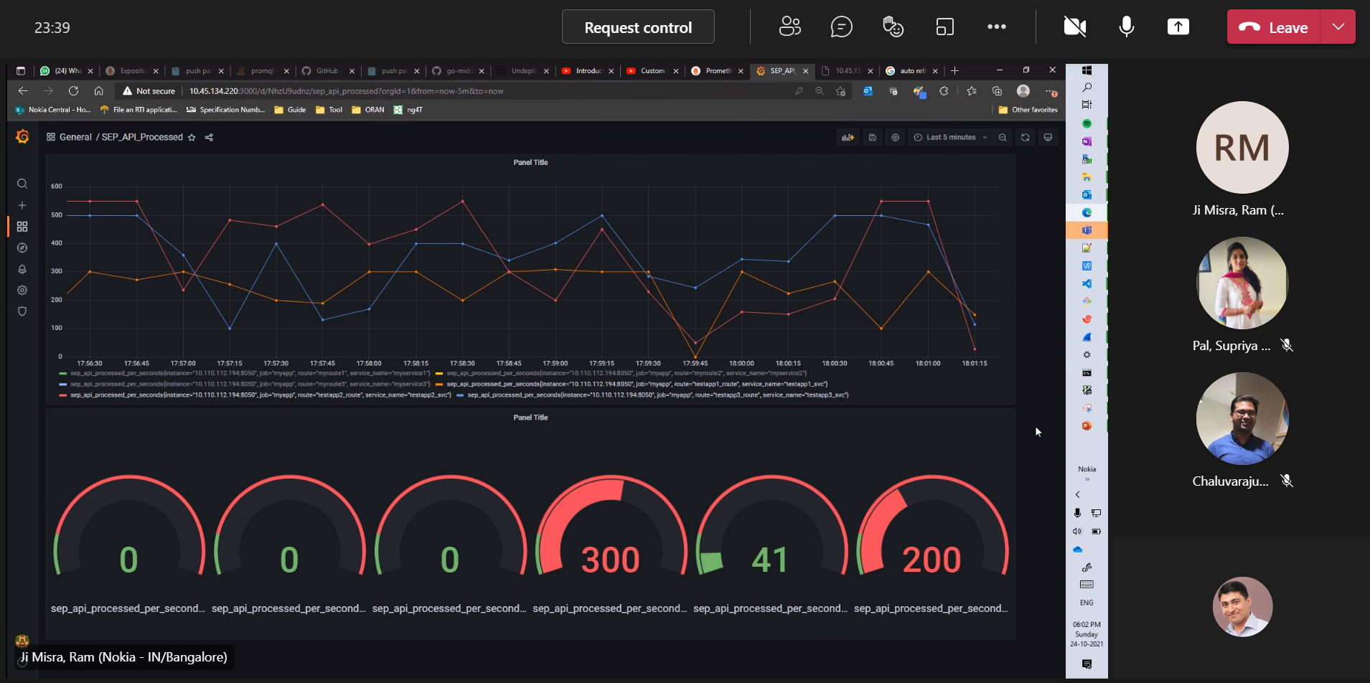

Slide 7
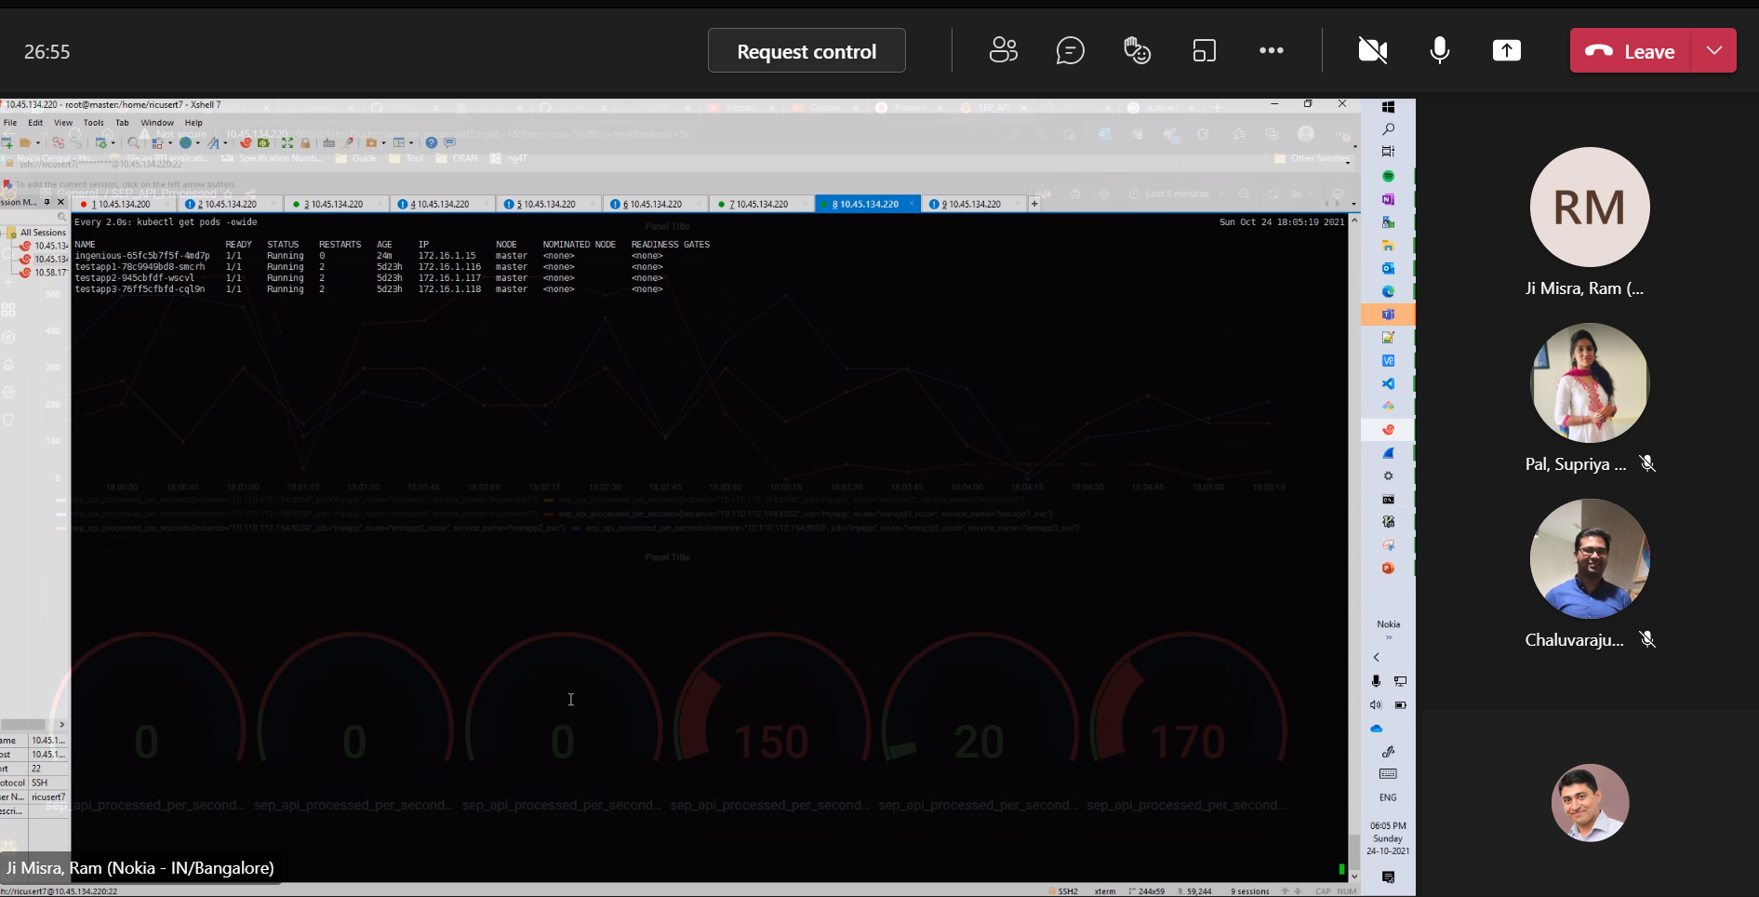

Slide 9
Euphoria-Hackathon Scoring Principles - Guidelines
Baseline concept (25%)
Idea potential - revenue, savings, impact?
Is the idea a clever way to address the problem?
How well has the case for the concept been made?
Is the problem and its solution important for Nokia?
How feasible is it to realize the concept?
How well does it uniquely leverage Nokia business domains?
What is the incremental benefit, the level of disruption to status quo?.
Design (25%)
Is there a high level design to the proposed concept?
This could describe a user experience, or a technical architecture, or both
In a smaller scale, the design could be a description of a new module/component, or a peripheral user interface to solve a small but significant problem
Explain the innovative part of your new design hack
Implementation (50%)
Is there an implementation of the proposed design?
Is the Implementation Complete or Partial?
Can it be made to scale to production, or does it need a complete re-thinking for productization?

